Slide 1


Introduction to the FreeSurfer Functional Analysis Stream
(FSFAST)

Slide 2
Administration
surfer.nmr.mgh.harvard.edu
  Register
  Download
  Mailing List
Wiki: surfer.nmr.mgh.harvard.edu/fswiki
Platforms: Linux and Mac
Bug Reporting
  Version
  Command-line
  Error description
  subjid/scripts/recon-all.log
  freesurfer@nmr.mgh.harvard.edu

Slide 3
Administration
As of 7/27/2010 FreeSurfer Version 5 not officially released
It is available locally
FS-FAST stable enough to use
source /usr/local/freesurfer/nmr-stable5-env
Don’t use for anatomical analysis

Slide 4
FSFAST Is …
Time-series functional analysis
  Event-related
  Blocked
  Retinotopy
Surface-, Volume-, ROI-based
Group Analysis
Highly Automated
Command-line driven
Matlab used in the background
  Can now use Octave!

Slide 5
FSFAST Pipeline Summary
Analyze anatomicals in FreeSurfer
Unpack each subject (dcmunpack,unpacksdcmdir)
Create subjectname file.
Copy paradigm files into run directories
Configure analyses (mkanalysis-sess, mkcontrast-sess)
Preprocess (preproc-sess)
First Level Analysis (selxavg3-sess)
Higher Level Analysis (isxconcat-sess, mri_glmfit)

Slide 6
FSFAST Directory Structure
Project
1. Project
Sess01
Sess02
Sess03
2. Session
bold
bold
3. Functional
Subdirectory
(FSD, “bold”)
003
005
006
4. Run
f.nii (raw data)
5. Raw Time-
Series Data

Slide 7
Project Directory
Project
Folder where all/most of your data reside (can use symbolic links to data too)
Directory where you will run most commands
Space approx 30 times your raw functional data
NOT the same as $SUBJECTS_DIR
Sess01
bold
003
f.nii (raw data)

Slide 8
Session Directory
Project
All the data collected between the time you put a subject into the scanner until you take him/her out.
  May include data across “breaks”
All one subject
Data from one subject may be spread over different sessions (eg, longitudinal study)
Session does not necessarily equal Subject
Folder name can be anything.
Sess01
bold
003
f.nii (raw data)

Slide 9
Functional Subdirectory (FSD, “bold”)
Project
All the data associated with a given paradigm
Most people just have one paradigm and so only one FSD
Usually called “bold”
Default is “bold”
Sess01
bold
003
f.nii (raw data)

Slide 10
Run Folder/Directory
Project
All the data collected between pressing the “Apply” button and the end of the scan.
Eg, 150 time points (TPs)
Raw functional data stored in this folder
Usually called “f.nii” or “f.nii.gz”
Raw data will be in “native functional space”, eg, 64x64x30, 3.125mm x 3.125mm x 6mm
Folder name will be 3-digit, zero-padded number, eg, “002”, “014”
Sess01
bold
003
f.nii (raw data)

Slide 11
FSFAST Directory Structure
Project
1. Project
Sess01
Sess02
Sess03
2. Session
bold
bold
3. Functional
Subdirectory
(FSD, “bold”)
003
005
006
4. Run
f.nii (raw data)
5. Raw Time-
Series Data

Slide 12
Setting Up the Directory Structure
Things you need to do before running automated commands:
Unpack raw data from DICOM
Add paradigm files
Add subjectname file

Slide 13
1. Unpacking: Creating the Directory Structure from DICOM Files
unpacksdcmdir – Siemens only
dcmunpack – Siemens or GE (not sure about Philips)
Getting help:
dcmunpack -help
Get a summary of the scans in a DICOM directory
dcmunpack –src dicomdir -martinos
Sess01
bold
Unpack:
cd ProjectDir
dcmunpack –src dicomdir -martinos
–trg sess01
–run 3 bold nii f.nii
–run 5 bold nii f.nii
–run 6 bold nii f.nii
003
005
006
f.nii
f.nii
f.nii

Slide 14
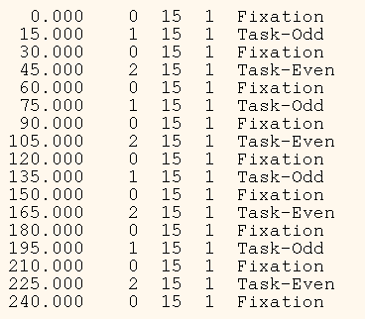
2. Add “Paradigm” File(s)
Codes Stimulus Schedule
Simple Text File
Manually copy into Run Folder
Sess01
bold
odd.even.par
003
005
006
f.nii
odd.even.par
f.nii
odd.even.par
f.nii
odd.even.par
All have the same name
May have different content
Different codings have different names

Slide 15
Paradigm File
Codes Stimulus Schedule (and Weight)
Four Columns
  Onset Time (Since Acq of 1st Saved Volume)
  Stimulus Code (0, 1, 2 ,3 …)
  Stimulus Duration
  Stimulus Weight (default is 1)
  Any other columns ignored
Simple Text File
Code 0 Always Fixation/NULL
Version 5 requires 4-column!

Slide 16
3. Add “subjectname” file
Integration with FreeSurfer anatomical analysis
Subject name is name passed to recon-all, eg,
  recon-all –all –subject bert
  $SUBJECTS_DIR/bert
Create a text file called “sess01/subjectname”, the content of the file will be, eg, “bert” (no quotes)
Sess01
bold
subjectname
003
005
006
f.nii
odd.even.par
f.nii
odd.even.par
f.nii
odd.even.par

Slide 17
Congratulations: You are now ready to start running the “automated” commands … but before you do …

Slide 18
Session Id File (“SessId”)
Project
Sess01
Sess02
Sess03
sessid
Text file with a list of sessions to process
Easy way to keep track of groups
Can have more than one
A good way to parallelize
FS-FAST Commands will often take a SessId file as input:
selxavg3-sess –sf sessid …
Will run for all sessions found in sessid
Alternatively, selxavg3-sess –s Sess01 –s Sess02 –s Sess03
Sess01
Sess02
Sess03

Slide 19
OK, now you are ready to start running the “automated” commands …

Slide 20
First-Level Analysis
Time-series analysis
Everything inside of a functional subdir (all runs)
Preprocessing
GLM Analysis
Sess01
bold
subjectname
003
005
006
f.nii
odd.even.par
f.nii
odd.even.par
f.nii
odd.even.par

Slide 21
Preprocessing
Registration Template Creation
Motion Correction
Slice-timing correction (if using)
Functional-Anatomical Registration
Mask creation
Intensity normalization, Part 1
Resampling raw time series to mni305, lh, and rh
Spatial smoothing
No automated B0 distortion correction yet

Slide 22
Preprocessing Command
preproc-sess
–sf sessids
–surface fsaverage lhrh
–mni305
–fwhm 5
–per-run
Command Name
Session Id File
Do surface-based on
lh and rh of fsaverage
Do volume-based in mni305
Smoothing 5mm FWHM
Run-wise registration
preproc-sess -help

Slide 23
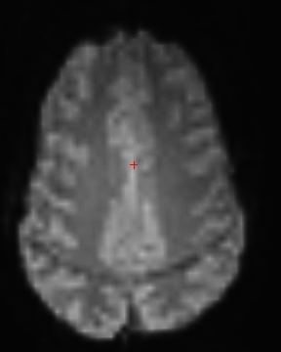
Preproc: 1. Registration Template
Used to align everything within a run
  Motion Correction
  Functional-Structural Registration
Middle time point of run
A different template for each run
Used to create masks
Like example_func in FSL
bold
003
005
f.nii
odd.even.par
template.nii
template.log
Version 4.5 implicitly used 1st time point of 1st run. Can still do it this way.

Slide 24
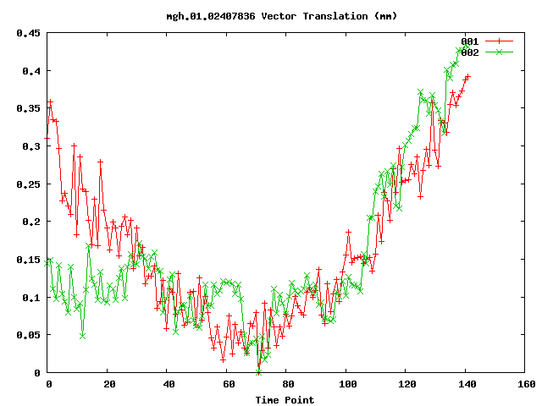
Preproc: 2. Motion Correction
Align all time points to template (AFNI)
fmcpr.nii – motion corrected data
fmcpr.mcdat – motion parameters
mcprextreg – motion parameters that can be used as nuisance variables in analysis
mc-sess
Use plot-twf-sess to plot vector translation
bold
003
005
f.nii
odd.even.par
template.nii
template.log
fmcpr.nii
fmcpr.mcdat
mcprextreg

Slide 25
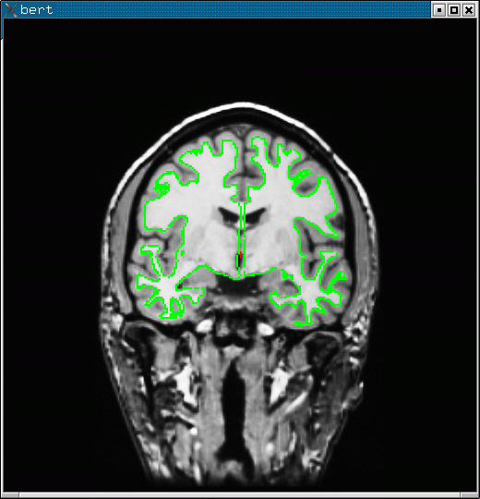
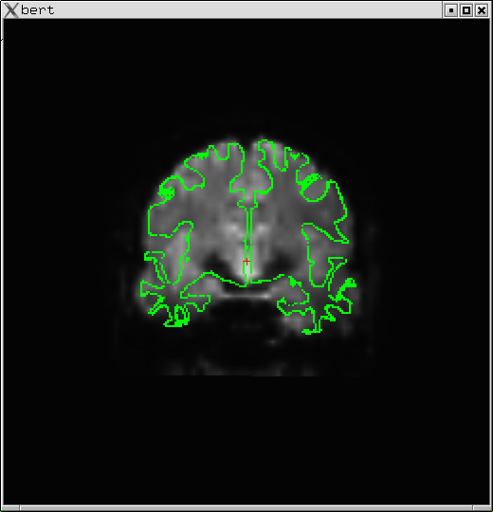
Preproc: 3. Anatomical-Functional Registration
Align template to FreeSurfer anatomical
  subjectname file – make sure it is right!
  Initialized with FSL/FLIRT (or SPM)
  Finalizes with BBR
  Default is 6 DOF
  Creates register.dof6.dat
Check with tkregister-sess
  Visually
  Final cost value
Advanced: Partial Field-of-view (FoV)
Sess01
subjectname
bold
003
005
f.nii
odd.even.par
template.nii
template.log
fmcpr.nii
fmcpr.mcdat
mcprextreg
register.dof6.dat

Slide 26
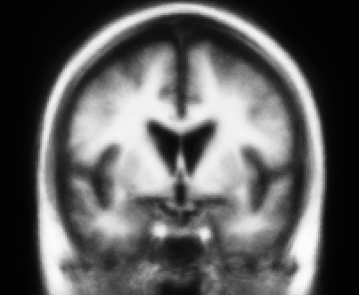
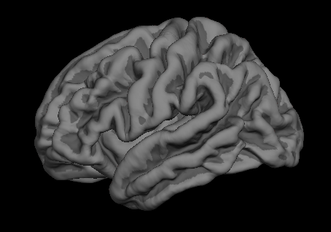
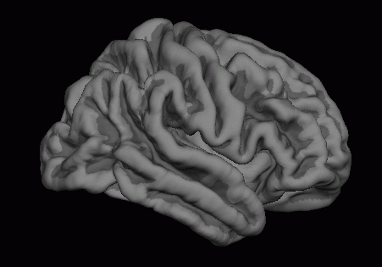
FSFAST Common Spaces
Common Space = space for group analysis
Multi-stage registration
One resampling
Three analyses (lh, rh, mni305)
Like three ROIs
76x76x96 2mm³
MNI305/
fsaverage
FSFAST
recon-all
lh fsaverage
Native
Functional
FreeSurfer
Anatomical
(orig.mgz)
rh fsaverage

Slide 27
Preproc: 4. Mask Creation
Creates mask folder in Run Directory
FSL BET run on the template
brain.nii – mask in native functional space
brain.fsaverage.?h.nii – mask in fsaverage surface space (masks out medial wall)
brain.mni305.2mm.nii – mask in mni305 2mm space
brain.e3.nii – brain eroded by 3vox, used for intensity normalization.
bold
003
005
f.nii
odd.even.par
template.nii
template.log
fmcpr.nii
fmcpr.mcdat
mcprextreg
register.dof6.dat
masks
brain.nii
brain.fsaverage.lh.nii
brain.fsaverage.rh.nii
brain.mni305.2mm.nii
brain.e3.nii

Slide 28
Preproc: 5. Intensity Normalization
Part 1: Compute global mean intensity inside of (eroded) mask across all time points
  global.meanval.dat
  global.waveform.dat
Part 2: Recompute the value at each voxel as:
  newvalue = oldvalue * 100/globalmean
  Done during analysis, not preproc
Interpret output as percent signal change
bold
003
005
f.nii
odd.even.par
template.nii
template.log
fmcpr.nii
fmcpr.mcdat
mcprextreg
register.dof6.dat
global.meanval.dat
global.waveform.dat
masks
brain.nii
brain.fsaverage.lh.nii
brain.fsaverage.rh.nii
brain.mni305.2mm.nii
brain.e3.nii

Slide 29
Preproc: 6. Resampling to common space
Time series is resampled
Native Functional (eg, 64x64x30xTimePoints)
MNI305 space – 2mm, 76x76x93xTimePoints
fsaverage surface
  163842x1x1xTimePoints
  Left Hemisphere (lh)
  Right Hemisphre (rh)
Trilinear interpolation
Data saved after spatial smoothing
Alternative: analyze in native anatomy (-self)
MNI305
lh fsaverage rh

Slide 30
Preproc: 7. Spatial Smoothing
Performed in group space (after interpolation)
Specify Full-Width/Half-Max (FWHM) in mm
Masked
MNI305 space – 3D spatial smoothing
fsaverage surface – 2D surface-based smoothing
  Don’t smooth across sulci/gyri
  Don’t smooth other tissue types in with gray matter
bold
003
005
f.nii
odd.even.par
template.nii
template.log
fmcpr.nii
fmcpr.mcdat
mcprextreg
register.dof6.dat
global.meanval.dat
fmcpr.sm5.fsaverage.lh.nii
fmcpr.sm5.fsaverage.rh.nii
fmcpr.sm5.mni305.2mm.nii

Slide 31
Preprocessing Command
preproc-sess
–sf sessids
–surface fsaverage lhrh
–mni305
–fwhm 5
–per-run
Command Name
Session Id File
Do surface-based on lh and rh
Do volume-based in mni305
Smoothing 5mm FWHM
Run-wise registration
preproc-sess -help

Slide 32
Preproc: Version 4.5 vs 5.0 Differences
You must have done anatomical analysis (recon-all)
  Can still use version 4.5 anatomy
Run-by-Run registration and MC.
Explicit Template Creation
Intensity normalization slightly different
Resample raw data to group space
Masked smoothing
Boundary-based registration (BBR)
Automatically checks whether preproc needs to be re-run
Can still do it the version 4.5 way (-native,-per-session)

Slide 33
First Level GLM Analysis
Specify Task Model
  Event-related or Blocked
  AB-Blocked (Periodic two condition)
  Retinotopy
  Task timing
  Hemodynamic Response Function (HRF)
  Contrasts
Specify Nuisance and Noise Models
  Low frequency drifts
  Time point exclusion
  Motion
  Other (Physiology, RETROICOR)
  Temporal Whitening

Slide 34
First Level GLM Analysis: Workflow
Do this once regardless of number of sessions:
  Configure “Analysis” – collection of parameters, mkanalysis-sess
  Create Contrasts (mkcontrast-sess)
  Don’t even need data to do this
Do this for each session:
  Perform Analysis (selxavg3-sess)

Slide 35
Configure First Level GLM Analysis
cd ProjectDir
mkanalysis-sess
-analysis oddeven.sm5.lh
-surface fsaverage lh
-fwhm 5
-paradigm oddeven.par
-event-related
-gammafit 2.25 1.25
-refeventdur 4
-polyfit 2
-mcextreg
-nskip 4
-TR 2 -nconditions 2
Project
Sess01
Sess02
mkanalysis-sess –help (Currently, GUI has been disabled)

Slide 36
Configuration: Analysis Name
Project
mkanalysis-sess
-analysis oddeven.sm5.lh
-surface fsaverage lh
-fwhm 5
-paradigm oddeven.par
-event-related
-gammafit 2.25 1.25
-refeventdur 4
-polyfit 2
-mcextreg
-nskip 4
-TR 2 -nconditions 2
oddeven.sm5.lh
Sess01
Sess02
analysis.info
Analysis Name – name used to
reference this collection of parameters. Use a different name for a different set of parameters.

Slide 37
Configuration: Preprocessing
bold
mkanalysis-sess
-analysis oddeven.sm5.lh
-surface fsaverage lh
-fwhm 5
-paradigm oddeven.par
-event-related
-gammafit 2.25 1.25
-refeventdur 4
-polyfit 2
-mcextreg
-nskip 4
-TR 2 -nconditions 2
003
005
fmcpr.sm5.fsaverage.lh.nii
fmcpr.sm5.fsaverage.rh.nii
fmcpr.sm5.mni305.2mm.nii
Preprocessing options indicate what
the source time-series file name will be.

Slide 38
Configuration: Preprocessing
bold
mkanalysis-sess
-analysis oddeven.sm5.mni305
-mni305 2
-fwhm 5
-paradigm oddeven.par
-event-related
-gammafit 2.25 1.25
-refeventdur 4
-polyfit 2
-mcextreg
-nskip 4
-TR 2 -nconditions 2
003
005
fmcpr.sm5.fsaverage.lh.nii
fmcpr.sm5.fsaverage.rh.nii
fmcpr.sm5.mni305.2mm.nii
A new analysis is needed for each space (lh, rh, and mni305)
Project
oddeven.sm5.lh
oddeven.sm5.mni305

Slide 39
Configuration: Stimulus Timing
bold
mkanalysis-sess
-analysis oddeven.sm5.lh
-surface fsaverage lh
-fwhm 5
-paradigm oddeven.par
-event-related
-gammafit 2.25 1.25
-refeventdur 4
-polyfit 2
-mcextreg
-nskip 4
-TR 2 -nconditions 2
003
005
fmcpr.sm5.fsaverage.lh.nii
fmcpr.sm5.fsaverage.rh.nii
fmcpr.sm5.mni305.2mm.nii
oddeven.par

Slide 40
Configuration: Task Type
mkanalysis-sess
-analysis oddeven.sm5.lh
-surface fsaverage lh
-fwhm 5
-paradigm oddeven.par
-event-related
-gammafit 2.25 1.25
-refeventdur 4
-polyfit 2
-mcextreg
-nskip 4
-TR 2 -nconditions 2
Event-related and blocked are the same. Other possibilities are:
-abblocked
-retinotopy

Slide 41
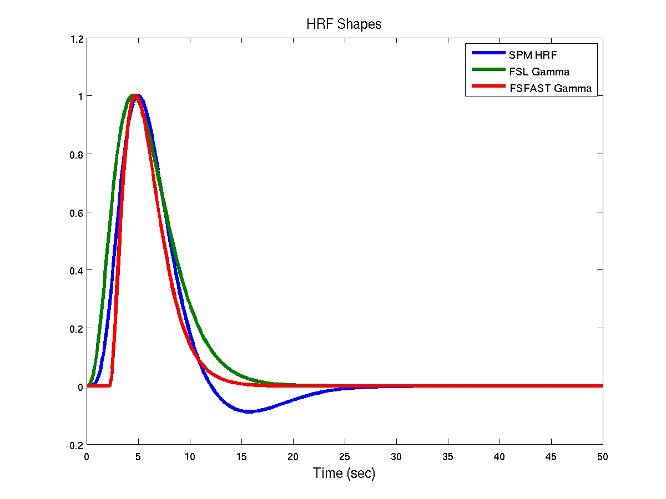
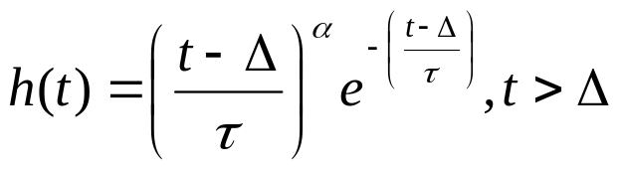
Configuration: HRF Model
mkanalysis-sess
-analysis oddeven.sm5.lh
-surface fsaverage lh
-fwhm 5
-paradigm oddeven.par
-event-related
-gammafit 2.25 1.25
-refeventdur 4
-polyfit 2
-mcextreg
-nskip 4
-TR 2 -nconditions 2
SPM
FSL
FSFAST
Dale and Buckner, 1997, HBM 5:329-340. Δ=2.25s, τ=1.25s, α=2
Other options:
-spmhrf N (N = number of derivatives)
-fir PreStim TotTimeWindow

Slide 42
Configuration: Reference Event Duration
mkanalysis-sess
-analysis oddeven.sm5.lh
-surface fsaverage lh
-fwhm 5
-paradigm oddeven.par
-event-related
-gammafit 2.25 1.25
-refeventdur 4
-polyfit 2
-mcextreg
-nskip 4
-TR 2 -nconditions 2
Just set this to the duration of your event in seconds.

Slide 43
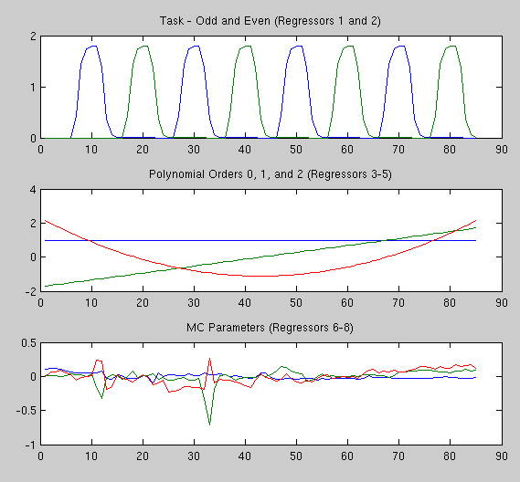
Configuration: Nuisance Drift Modeling
mkanalysis-sess
-analysis oddeven.sm5.lh
-surface fsaverage lh
-fwhm 5
-paradigm oddeven.par
-event-related
-gammafit 2.25 1.25
-refeventdur 4
-polyfit 2
-mcextreg
-nskip 4
-TR 2 -nconditions 2
2nd Order Polynomial. This is the default.
0: mean offset
1: temporal trend
2: quadradic trend
Can also specify a high-pass filter with
-hpf CutOffHz
where CutOffHz is the cut-off frequency in Hz (eg, .01). Careful with this.

Slide 44
Configuration: Nuisance Motion
bold
mkanalysis-sess
-analysis oddeven.sm5.lh
-surface fsaverage lh
-fwhm 5
-paradigm oddeven.par
-event-related
-gammafit 2.25 1.25
-refeventdur 4
-polyfit 2
-mcextreg
-nskip 4
-TR 2 -nconditions 2
003
005
f.nii
odd.even.par
template.nii
template.log
fmcpr.nii
fmcpr.mcdat
mcprextreg
Use Motion Correction parameters as nuisance regressors. Can specify arbitrary regressor files with “–nuisreg file N”.
A good idea?

Slide 45
Configuration: Excluding Time Points
bold
mkanalysis-sess
-analysis oddeven.sm5.lh
-surface fsaverage lh
-fwhm 5
-paradigm oddeven.par
-event-related
-gammafit 2.25 1.25
-refeventdur 4
-polyfit 2
-mcextreg
-nskip 4
-TR 2 -nconditions 2
003
005
f.nii
odd.even.par
template.nii
template.log
fmcpr.nii
fmcpr.mcdat
mcprextreg
tpexclude.dat
Skip the 1st 4 time points. Do not need to adjust stimulus timing. Alternative:
“-tpexclude tpexclude.dat” to remove any TP. Good for motion.

Slide 46
Configuration: Why TR and NCond?
mkanalysis-sess
-analysis oddeven.sm5.lh
-surface fsaverage lh
-fwhm 5
-paradigm oddeven.par
-event-related
-gammafit 2.25 1.25
-refeventdur 4
-polyfit 2
-mcextreg
-nskip 4
-TR 2 -nconditions 2
It could get this from the data and paradigm files, but this command is set up to run without the need of any data, so it
needs to know the TR and number of conditions.
Number of conditions is the number of Non-Fixation/Non-NULL conditions.

Slide 47
Configuration: External Regressor Files
Text file(s)
Same folder as the raw data
One row for each time point
Can have multiple columns
Task
  -taskreg taskreg.dat
  Continuous task variable (eg, RT)
  Contrast (vs baseline) will be automatic
Nuisance
  -nuisreg nuisreg.dat
  Physiology (eg, RETROICOR)
bold
003
005
f.nii
odd.even.par
template.nii
template.log
fmcpr.nii
fmcpr.mcdat
mcprextreg
taskreg.dat
nuisreg.dat

Slide 48
Configuration: Temporal Whitening
AR(1) Model:
Compute voxel-wise raw AR(1) based on the residuals
“Fixes” AR(1) for bias in residuals (based on X)
Spatially smooths
Divide into 30 bins
On by default. Use -nowhiten to turn off
-fsv3-whiten to use version 3 style whitening
On by default, but how useful?

Slide 49
Configuration: Contrasts
Linear combination of regression coefficients (COPE, CON)
Embodies a hypothesis:
Does the hemodynamic response amplitude to the
Odd stimulus differ from baseline/fixation?
mkcontrast-sess
-analysis oddeven.sm5.lh
-contrast odd-vs-fix
-a 1
-c 0
paradigm file

Slide 50
Configuration: Contrasts
-analysis as created by mkanalysis-sess
mkcontrast-sess
-analysis oddeven.sm5.lh
-contrast odd-vs-fix
-a 1
-c 0
Project
oddeven.sm5.lh
Sess01
analysis.info
odd-vs-fix.mat

Slide 51
Configuration: Contrasts
-contrast ContrastName
name used to reference this contrast
unique within the given analysis
Creates ContrastName.mat (matlab)
mkcontrast-sess
-analysis oddeven.sm5.lh
-contrast odd-vs-fix
-a 1
-c 0
Project
oddeven.sm5.lh
Sess01
analysis.info
odd-vs-fix.mat

Slide 52
Configuration: Contrasts
Contrast Condition Specification
“Active” – positive, “Control” – negative
Odd vs Fixation means Odd-Fixation
Do not need Fixation-Odd
Paradigm file coding
mkcontrast-sess
-analysis oddeven.sm5.lh
-contrast odd-vs-fix
-a 1
-c 0
paradigm file

Slide 53
Configuration: More Contrasts
Project
mkcontrast-sess
-analysis oddeven.sm5.lh
-contrast even-vs-fix
-a 2
-c 0
oddeven.sm5.lh
Sess01
analysis.info
odd-vs-fix.mat
even-fs-fix.mat
odd-vs-even.mat
mkcontrast-sess
-analysis oddeven.sm5.lh
-contrast odd-vs-even
-a 1
-c 2

Slide 54
Configuration: Three Conditions
Happy
Sad
Mad
Hypothesis: response to Happy is different than Mad
mkcontrast-sess
-analysis faces.sm5.lh
-contrast happy-vs-mad
-a 1
-c 3
Note: Condition 2 (Sad) not represented (set to 0)
Hypothesis: response to Happy is different than the average response to Sad and Mad (Happy =? (Sad+Mad)/2)
mkcontrast-sess
-analysis faces.sm5.lh
-contrast happy-vs-sadmad
-a 1
-c 2
-c 3

Slide 55
Configuration: Summary
mkanalysis-sess, mkcontrast-sess
Need configuration for lh, rh, and mni305
Specify: Preproc, Task, Nuisance, Noise, Contrasts
Does not do analysis, just creates configuration
Do once for each configuration
Do once regardless of number of sessions
Should take a few seconds to run
Project
oddeven.sm5.lh
Sess01
analysis.info
odd-vs-fix.mat

Slide 56
First-Level GLM Analysis
cd ProjectDir
selxavg3-sess –sf sessidfile –analysis oddeven.sm5.lh
Finds raw data, paradigm file, external regressors, etc
Constructs design and contrast matrices
Combines runs together using “smart” concatenation (1st and 2nd level)
Performs GLM fit at each voxel
Tests contrasts at each voxel
All sessions specified in sessid file
May take a few hours, depending on how many sessions
Does not re-run if data are “up-to-date”
Will run preprocessing if not done already
Requires matlab or octave

Slide 57
First Level Analysis Results
selxavg3-sess –sf sessidfile –analysis oddeven.sm5.lh
Created by mkanalysis-sess
and mkcontrast-sess
Project
oddeven.sm5.lh
Sess01
Sess02
analysis.info
odd-vs-fix.mat
even-fs-fix.mat
odd-vs-even.mat
bold
Created by selxavg3-sess.
All runs combined.
003
005
oddeven.sm5.lh
f.nii (raw data)
odd-vs-fix
even-vs-fix
odd-vs-even
Contrasts

Slide 58
First Level Analysis Results
selxavg3-sess –sf sessidfile –analysis oddeven.sm5.lh
Sess01
bold
oddeven.sm5.lh
analysis.info - copy
meanfunc.nii – mean image
beta.nii – regression coefficients
rvar.nii – residual variance
mask.nii – final mask
X.mat – design matrix, etc, (matlab)
fs.build-stamp.txt – freesurfer version
More …
odd-vs-fix
even-vs-fix
odd-vs-even

Slide 59
First Level Analysis Results
selxavg3-sess –sf sessidfile –analysis oddeven.sm5.lh
bold
oddeven.sm5.lh
analysis.info - copy
meanfunc.nii – mean image
beta.nii – regression coefficients
rvar.nii – residual variance
mask.nii – final mask
X.mat – design matrix, etc, (matlab)
fs.build-stamp.txt – freesurfer version
More …
odd-vs-fix
even-vs-fix
odd-vs-even
ces.nii – contrast values
cesvar.nii – variance of contrast
sig.nii – contrast significance (signed)
fsig.nii – contrast significance (unsigned)
More …

Slide 60
Notes about Significance Files
sig.nii, fsig.mgh sig.mgh, …
p-value is number between 0 and 1 (False Positive Rate)
Closer to 0 is more significant (ie, smaller is better)
In FreeSurfer, all p-values are for unsigned/two-sided tests
“sig” – signed values, “fsig” – unsigned values
In FreeSurfer the “significance” is –log10(p)*sign(contrast)
Example: p = .01 = 10⁻²; log10(p) = -2, -log10(p) = +2
Contrast Sign [sign(contrast)] :
Odd > Even, p = .01, sig = +2 (red/yellow)
Odd < Even, p = .01, sig = -2 (blue/cyan)
p | Exp | -log10(p)
0.1 | 10⁻¹ | 1
0.05 | 10^{-1.3} | 1.3
0.01 | 10⁻² | 2
0.001 | 10⁻³ | 3
0.0001 | 10⁻⁴ | 4
mkcontrast-sess
-analysis oddeven.sm5.lh
-contrast odd-vs-even
-a 1
-c 2

Slide 61
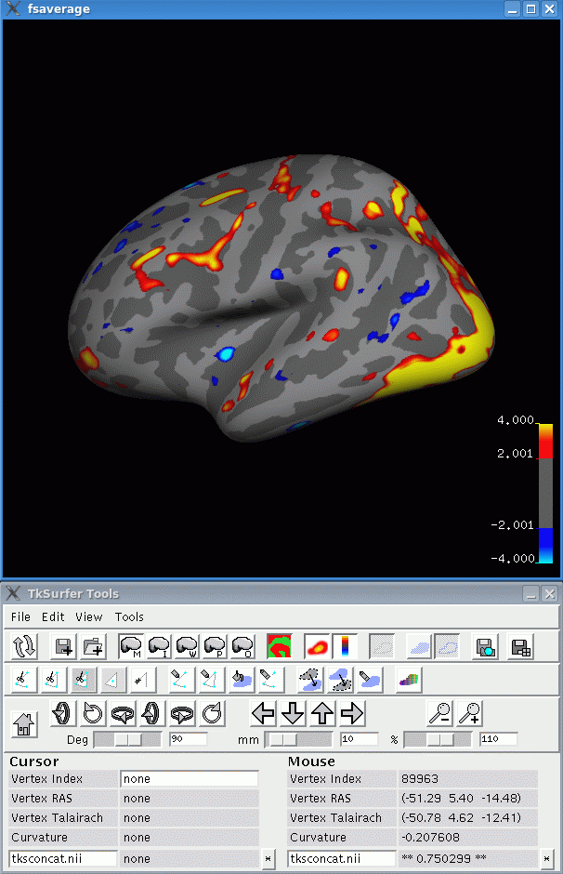
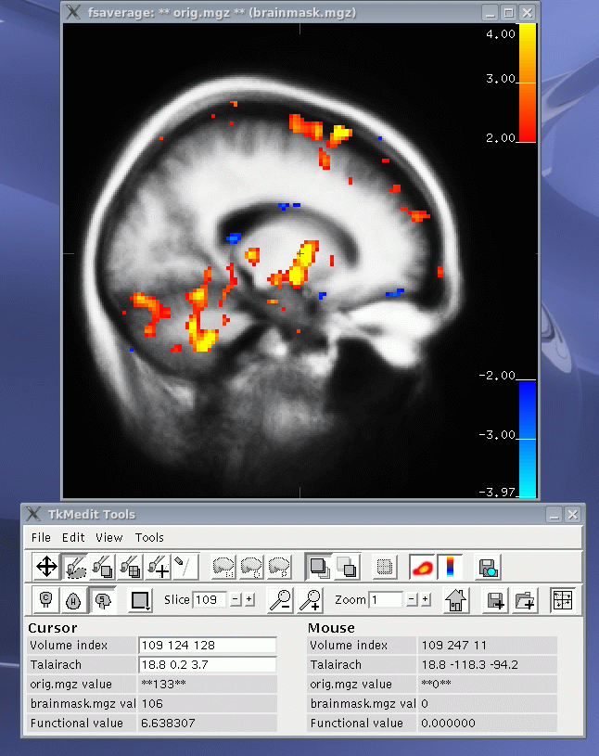
First Level Analysis: Visualization
sig.nii, Red/Yellow: Contrast>0; Blue/Cyan: Contrast<0

Slide 62
First Level Analysis: Visualization
Surface-based analyses:
tksurfer-sess –s session –analysis oddeven.sm5.lh –c odd-vs-fix
tksurfer-sess –s session –a oddeven.sm5.rh –c odd-vs-fix
Volume-based analyses:
tkmedit-sess –s session –a oddeven.sm5.mni305 –c odd-vs-fix
tksurfer-sess –s session –a oddeven.sm5.mni305 –c odd-vs-fix
One session at a time (-s session, NOT –sf sessidfile)
Can specify multiple contrasts, eg,
–c odd-vs-fix –c even-vs-fix –c odd-vs-even
Or all contrasts with “-call”
Note Shortcut: “-a” instead of “-analysis” and “-c instead of –contrast”

Slide 63
After First Level Analysis…
Project
1. Project
Sess01
Sess02
Sess03
…
2. Session
3. Functional
Subdirectory
(FSD, “bold”)
bold
bold
bold
oddeven.sm5.lh
oddeven.sm5.lh
oddeven.sm5.lh
4. Analysis Folder
odd-vs-even
odd-vs-even
odd-vs-even
5. Contrast Folder
ces.nii
ces.nii
ces.nii
6. Contrast Values

Slide 64
Group/Higher Level Analysis: Consolidation
cd ProjectDir
isxconcat-sess
-analysis oddeven.sm5.lh
-contrast odd-vs-even
-sf group1.sessid
-o group1
Project
Sess01
Sess02
Sess03
group1
isxconcat-sess -help
bold
bold
bold
oddeven.sm5.lh
odd-vs-even
oddeven.sm5.lh
oddeven.sm5.lh
oddeven.sm5.lh
ces.nii
odd-vs-even
odd-vs-even
odd-vs-even
ces.nii
ces.nii
ces.nii

Slide 65
Group/Higher Level Analysis: Consolidation
Project
Sess01
Sess02
Sess03
group1
bold
bold
bold
oddeven.sm5.lh
odd-vs-even
oddeven.sm5.lh
oddeven.sm5.lh
oddeven.sm5.lh
ces.nii
odd-vs-even
odd-vs-even
odd-vs-even
ces.nii
ces.nii
ces.nii
isxconcat-sess
-analysis oddeven.sm5.lh
-contrast odd-vs-even
-sf group1.sessid
-o group1
One frame/time point for each session
Order is IMPORTANT!!!
Order will be as listed in group1.sessid

Slide 66
Group/Higher Level Analysis
cd ProjectDir
cd group1/oddeven.sm5.lh/odd-vs-even
mri_glmfit
--surf fsaverage lh
--y ces.nii
--fsgd group1.fsgd
--C group.con1.mtx
--C group.con2.mtx
--glmdir glm.group
Project
group1
oddeven.sm5.lh
odd-vs-even
ces.nii
glm.group
See FreeSurfer Group Analysis, including correction for multiple comparisons.
http://surfer.nmr.mgh.harvard.edu/fswiki/FsTutorial/GroupAnalysis
mri_glmfit –help

Slide 67
Group/Higher Level Analysis
mri_glmfit
--surf fsaverage lh
--y ces.nii
--fsgd group1.fsgd
--C group.con1.mtx
--C group.con2.mtx
--glmdir glm.group
Surface-based analysis on the left
hemisphere of fsaverage.
For right hemisphere, use
“–surf fsaverage rh”.
For mni305, so not specify –surf.

Slide 68
Group/Higher Level Analysis
mri_glmfit
--surf fsaverage lh
--y ces.nii
--fsgd group1.fsgd
--C group.con1.mtx
--C group.con2.mtx
--glmdir glm.group
Input data, one frame/time point for each subject.

Slide 69
Group/Higher Level Analysis
mri_glmfit
--surf fsaverage lh
--y ces.nii
--fsgd group1.fsgd
--C group.con1.mtx
--C group.con2.mtx
--glmdir glm.group
FSGD file must have same order
of sessions as sessidfile used
when running isxconcat-sess
isxconcat-sess
-analysis oddeven.sm5.lh
-contrast odd-vs-even
-sf group1.sessid
-o group1

Slide 70
Group/Higher Level Analysis
mri_glmfit
--surf fsaverage lh
--y ces.nii
--fsgd group1.fsgd
--C group.con1.mtx
--C group.con2.mtx
--glmdir glm.group
Higher Level/Group contrasts. Easily confused with lower level contrasts (eg, odd-vs-even).

Slide 71
Group Analysis: Other isxconcat-sess outputs
Project
group1
oddeven.sm5.lh
odd-vs-even
analysis.info – copy
sessid.txt – session list, plus more info
masks.nii – masks for all subjects
mask.nii – intersection of all masks
subcort.mask.nii – mni305 only
More …
ces.nii
cesvar.nii – lower level variances

Slide 72
Group Analysis: Multiple Lower Level Contrasts
isxconcat-sess
-analysis oddeven.sm5.lh
-contrast odd-vs-even
-contrast odd-vs-fix
-sf group1.sessid
-o group1
Or just used –call for all
contrasts.
Project
group1
oddeven.sm5.lh
odd-vs-even
odd-vs-fix
ces.nii
ces.nii

Slide 73
Group MNI305 Analysis
isxconcat-sess
-analysis oddeven.sm5.mni305
-contrast odd-vs-even
-contrast odd-vs-fix
-sf group1.sessid
-o group1
Project
group1
oddeven.sm5.lh
oddeven.sm5.mni305
odd-vs-even
odd-vs-fix
odd-vs-even
odd-vs-fix
ces.nii
ces.nii
ces.nii
ces.nii

Slide 74
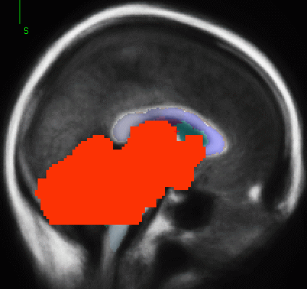
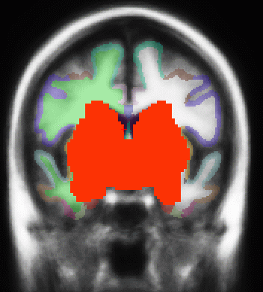
Group MNI305 Analysis
mri_glmfit
--y ces.nii
--fsgd group1.fsgd
--C group.con1.mtx
--C group.con2.mtx
--glmdir glm.group
--mask ../subcort.mask.nii
Command-line is very similar
No “–surf fsaverage lh”
Subcortical mask to exclude cortical regions

Slide 75
Full Group Analysis
Project
group1
oddeven.sm5.lh
oddeven.sm5.rh
oddeven.sm5.mni305
odd-vs-even
odd-vs-even
odd-vs-even
ces.nii
ces.nii
ces.nii
glm.group
glm.group
glm.group

Slide 76
FSFAST Pipeline Summary
Analyze anatomicals in FreeSurfer
Unpack each subject (dcmunpack,unpacksdcmdir)
Create subjectname file.
Copy paradigm files into run directories
Configure analyses (mkanalysis-sess, mkcontrast-sess)
Preprocess (preproc-sess)
First Level Analysis (selxavg3-sess)
Higher Level Analysis (isxconcat-sess, mri_glmfit)
Publish (publish-sess ☺)

Slide 77
ROI Analysis
Subject-non-specific
  Eg, after group analysis
Subject-specific
  Anatomically defined
  Anatomically and functionally defefined
  Average contrasts inside of ROI
Configure ROI (funcroi-config --help)
Get a table of values (funcroi-table-sess)
Version 4.5 commands:
func2roi-sess, roisummary-sess

Slide 78
Other Issues
Quality Assurance and Control (QA/QC)
Partial brain field-of-view
FIR Analyses and Multi-variate contrasts
External regressors
Seed-based functional connectivity
MNI305 subcortical masking
Correction for multiple comparisons
ROI analyses
Octave instead of matlab

